Slide 1











BY
Pasindu Mahima
Search . . .
NGATOR
LEARNING
SAD PRESENTATIONS
learn.ngator.com

Slide 2




BY
Pasindu Mahima
Search . . .
IMPORTANT POINTS TO REMEMBER
ACTION LISTENERS
JFRAME OPERATIONS
SOFTWARE FINALIZING
JASPER REPORTING
java.awt.event.*
javax.swing.event.*
java.beans.PropertyChangeEvent
GUI
Components
Creating a report
Sub Reporting
EXIT_ON_CLOSE
DO_NOTHING
DISPOSE
Logger
Unit Testing
jar, exe and setup files

Slide 3
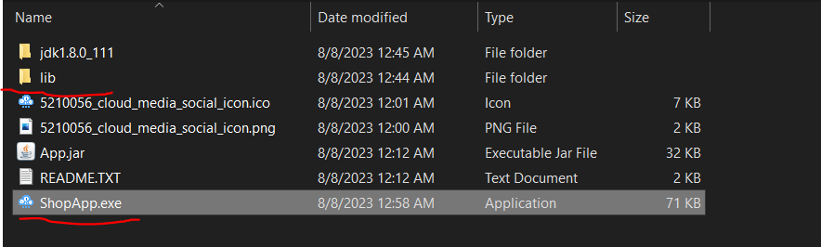
BY
Pasindu Mahima
Search . . .
SOFTWARE FINALIZATION
Regular Mode
In regular mode only the runnable jar file is wrapped around as an exe file. it does not contains library jar files. Libraries should
be distributed along with exe outside the exe file.

Slide 4
BY
Pasindu Mahima
Search . . .
SOFTWARE FINALIZATION
JAR in EXE Mode
In jar in exe mode all the library files are included inside the exe file. Therefore, the developer does not have to distribute jar file
with the exe file as all are included in one file.

Slide 5
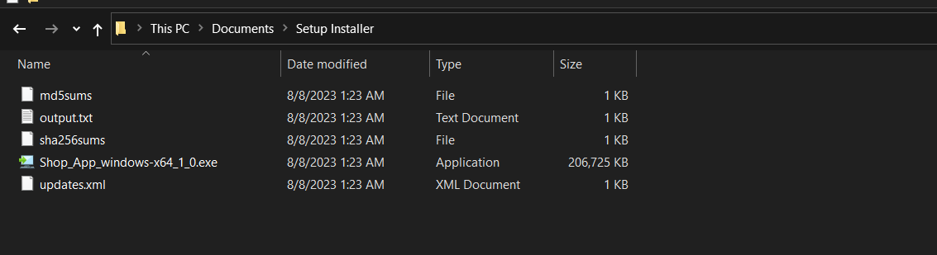
BY
Pasindu Mahima
Search . . .
SOFTWARE FINALIZATION
Setup mode
If you have a Java application converted to EXE and you wish to distribute it as an installable software package, you'd use a tool to create an installer or setup file that, when executed, installs your EXE (and possibly other associated files) onto the user's system.

Slide 6
BY
Pasindu Mahima
Search . . .
DIFFERENCE BETWEEN SETUP FILE AND JAR IN EXE MODE
If you have a Java application converted to EXE and you wish to distribute it as an installable software package, you'd use a tool to create an installer or setup file that, when executed, installs your EXE (and possibly other associated files) onto the user's system.A JAR in EXE mode by itself isn't a setup file. However, it can be packaged into a setup file for installation purposes.

Slide 7
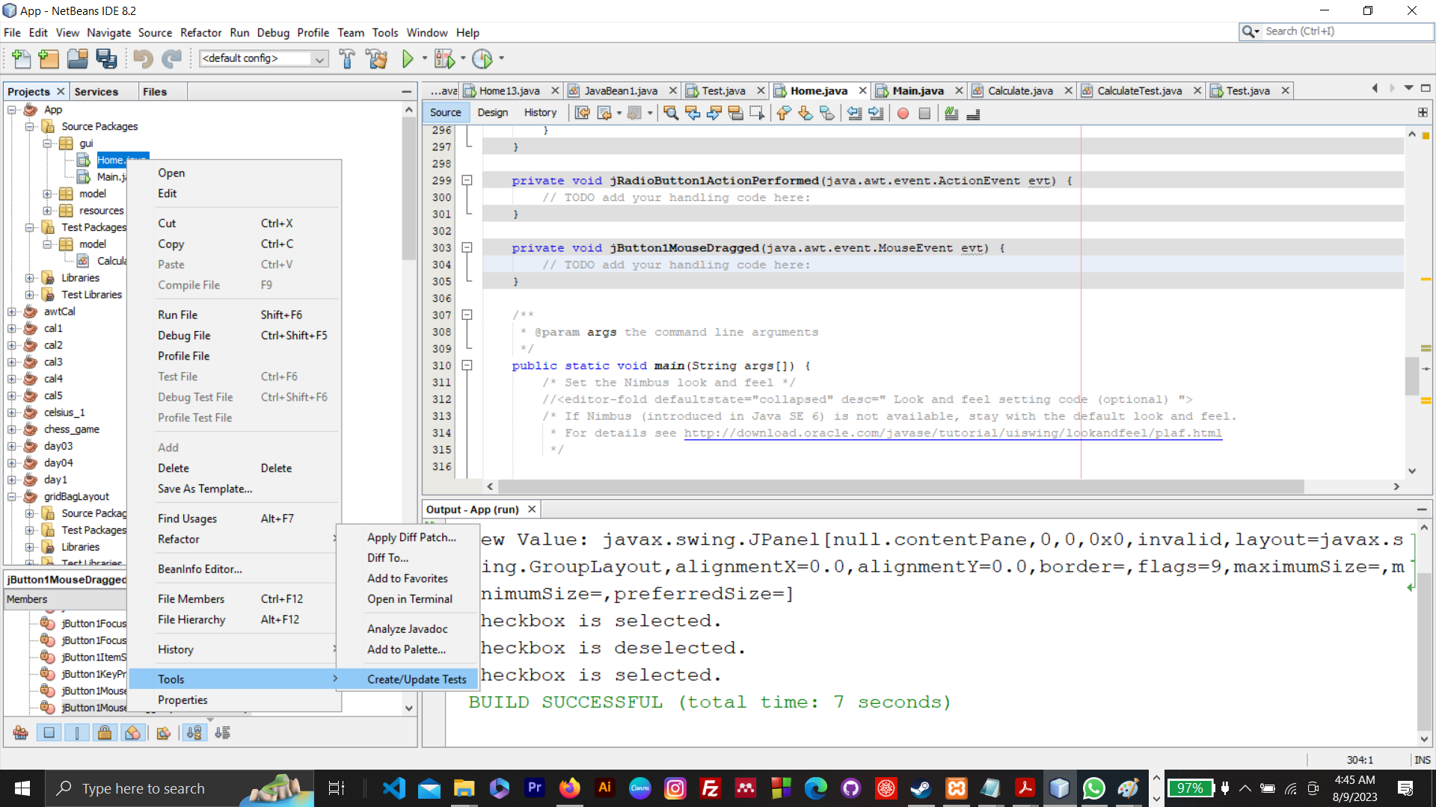
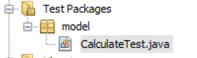
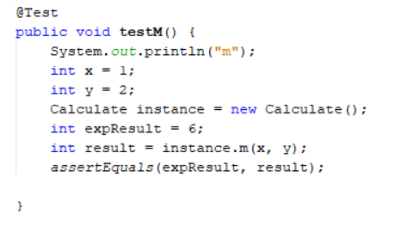
BY
Pasindu Mahima
Search . . .
UNIT TESTING

Slide 8
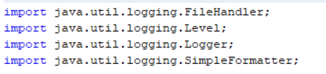
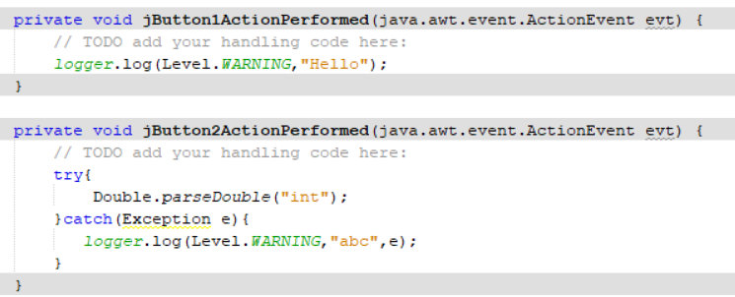
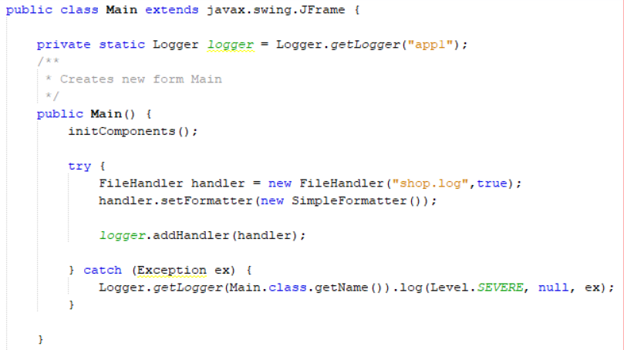
BY
Pasindu Mahima
Search . . .
LOGGER

Slide 9

BY
Pasindu Mahima
Search . . .
THANK YOU
Social Profiles
Follow Ngator on social networks
Facebook : https://www.facebook.com/learnwithngator
Instagram :https://www.instagram.com/mahimapasindu/
GitHub : https://github.com/drgnhunter
LinkedIn : https://www.linkedin.com/in/pasindu-mahima-3a0031187/
END SLIDE

